Slide 1


Systems Analysis & Design
Eleventh Edition
Chapter # 10
Object-Oriented Systems Analysis and Design Using U M L*
Copyright © 2024, 2019, 2014 Pearson Education, Inc. All Rights Reserved
Notes:
If this PowerPoint presentation contains mathematical equations, you may need to check that your computer has the following installed:
1) MathType Plugin
2) Math Player (free versions available)
3) NVDA Reader (free versions available)

Slide 2
Learning Objectives (1 of 2)
10.1 Understand what object-oriented systems analysis and design is and appreciate its usefulness.
10.2 Learn the basics of C R C cards and object think.
10.3 Comprehend the concepts of unified modeling language (U M L), the standard approach for modeling a system in the object-oriented world.
10.4 Explore use case modeling.
10.5 Learn how to draw and interpret activity diagrams.
10.6 Draw and explain sequence and communication diagrams.

Slide 3
Learning Objectives (2 of 2)
10.7 Be able to develop class diagrams.
10.8 Enhance sequence diagrams based on the class diagrams just developed.
10.9 Enhance call diagrams in a variety of ways.
10.10 Learn how to develop statechart diagrams.
10.11 Learn the fundamentals of decision trees.
10.12 Recognize how to put U M L to work.
10.13 Realize the importance of U M L for modeling.

Slide 4
Object-Oriented Analysis and Design (1 of 2)
Works well in situations where complicated systems are undergoing continuous maintenance, adaptation, and design
Objects, classes are reusable
The Unified Modeling Language (U M L) is an industry standard for modeling object-oriented systems.
Notes:
Object-oriented analysis and design can offer an approach that facilitates logical, rapid, and thorough methods for creating new systems responsive to a changing business landscape.
Object-oriented systems describe entities as objects where objects are part of a general concept called classes.
Reusable—means you can become more efficient, because you do not have to start at the beginning to describe an object every time it is needed for software development.
UML is a powerful tool that can greatly improve the quality of your systems analysis and design, and thereby help create higher-quality information systems.

Slide 5
Object-Oriented Analysis and Design (2 of 2)
Reusability
Recycling of program parts should reduce the costs of development in computer-based systems
Maintaining systems
Making a change in one object has a minimal impact on other objects

Slide 6
Major Topics
Object-oriented concepts
C R C cards and object think
Unified Modeling Language
Use case and other U M L diagrams
Packages
Using U M L

Slide 7
Object-Oriented Concepts
Objects
Classes
Inheritance
Notes:
Object-oriented programming differs from traditional programming by examining the objects that are part of a system.

Slide 8
Objects
Persons, places, or things that are relevant to the system being analyzed
May be customers, items, orders, and so on
May be G U I displays or text areas on a display
Notes:
Objects are represented by and grouped into classes that are optimal for reuse and maintainability.

Slide 9
Classes
Defines the set of shared attributes and behaviors found in each object in the class
Should have a name that differentiates it from all other classes
Instantiate is when an object is created from a class
An attribute describes some property that is possessed by all objects of the class
A method is an action that can be requested from any object of the class
Notes:
What makes object-oriented programming, and thus object-oriented analysis and design, different from classical programming is the technique of putting all of an object’s attributes and methods within one self-contained structure, the class itself.
Names—class names are usually nouns or short phrases and begin with an uppercase letter.
Instantiate—when a program runs, objects can be created from the established class.
Attribute—examples might be size, color, and make
Method—the processes that a class knows to carry out, also called an operation.

Slide 10
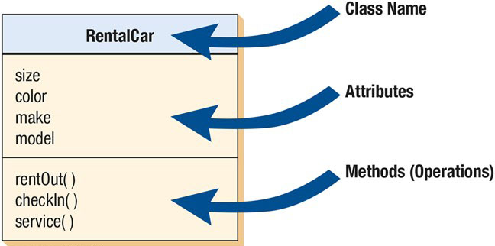
Figure 10.1 An Example of a U M L Class
Notes:
Long Description:
The illustration shows a rectangle which is divided horizontally into three sections. ● The first section shows Rental Car, which is the Class name. ● The second section shows attributes and consists of size, color, make, and model. ● The third section shows Methods (Operations), and consists of rent Out (), check In (), and service ().

Slide 11
Inheritance (1 of 2)
When a derived class inherits all the attributes and behaviors of the base class
Reduces programming labor by using common objects easily
A feature only found in object-oriented systems
Notes:
The parent class is called the base class.
The child class is called the derived class.
Allows the programmer to define once but use many times.

Slide 12
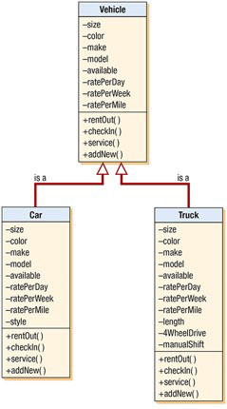
Figure 10.2 A Class Diagram Showing Inheritance
Car and truck are specific examples of vehicles and inherit the characteristics of the more general class vehicle.
Notes:
Long Description:
Car • size • color • make • model • available • ratePerDay • ratePerWeek • ratePerMile • style Plus rentOut( ) Plus checkIn( ) Plus service( ) Plus addNew( ) Truck • size • color • make • model • available • ratePerDay • ratePerWeek • ratePerMile • length • 4WheelDrive • manualShift Plus rentOut( ) Plus checkIn( ) Plus service( ) Plus addNew( ) • Vehicle • size • color • make • model • available • ratePerDay • ratePerWeek • ratePerMile Plus rentOut( ) Plus checkIn( ) Plus service( ) Plus addNew( )

Slide 13
C R C Cards and Object Think
C R C
Class
Responsibilities
Collaborators
C R C cards are used to represent the responsibilities of classes and the interaction between the classes
Notes:
CRC cards are created based on scenarios that outline system requirements.

Slide 14
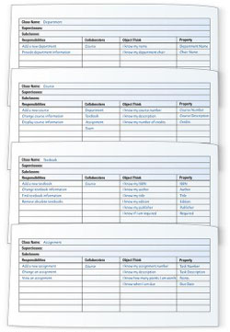
Figure 10.3 Four C R C Cards
Notes:
The purpose of the Object Think column and the Property column is to clarify thinking and help move toward creating the UML diagram.
Long Description:
All four tables begin with fields for filling in the following information: Class Name: Superclasses: Subclasses: After these details, the tables consist of four columns, with four column heads, Responsibilities, Collaborators, Object Think, and Property. The tables depict the following information: ● Table 1: Class Name: Department Row 1: Add a new department; Course; I know my name; Department name Row 2: Provide department information; blank; I know my department chair; Chair name. ● Table 2: Class Name: Course Row 1: Add a new course; Department; I know my course number; Course number Row 2: Change course information; Textbook; I know my description; Course description Row 3: Display course information; Assignment; I know my number of credits; Credits Row 4 shows Collaborators: Exam ● Table 3: Class Name: Textbook Row 1: Add a new textbook; Course; I know my I S B N; I S B N Row 2: Change textbook information; blank; I know my author; Author Row 3: Find textbook information; blank; I know my title; Title Row 4: Remove obsolete textbooks; blank; I know my edition; Edition Row 6: blank; blank; I know my publisher; Publisher Row 7: blank; blank; I know if I am required; Required ● Table 4: Class Name: Assignment Row 1: Add a new assignment; Course; I know my assignment number; Task number Row 2: Change an assignment; blank; I know my description; Task description Row 3: View an assignment; blank; I know how many points I am worth; Points Row 4: blank; blank; I know when I am due; Due date

Slide 15
Interacting During a C R C Session
Identify all the classes you can
Create scenarios
Identify and refine responsibilities
Notes:
Identify all the classes you can—when all classes have been identified, the analysts can then compile them, weed out the illogical ones, and write each one on its own card.
Creating scenarios—actual walkthroughs of system functions.
The responsibilities will eventually evolve into methods in the UML.
The think statements can later be converted to attributes in the UML.

Slide 16
The Unified Modeling Language (U M L) Concepts and Diagrams
Things
Relationships
Diagrams
Notes:
UML provides a standardized set of tools to document the analysis and design of a software system.
Things—the objects.
Relationships—the glue that holds things together.
Diagrams—categorized as either structural or behavioral.

Slide 17
Things
Structural things are:
Classes, interfaces, use cases, and other elements that provide a way to create models
They allow the user to describe relationships
Behavioral things
Describe how things work
Interactions and state machines
Group things
Used to define boundaries
Annotational things
Can add notes to the diagrams
Notes:
Things are the primary elements of the UML (objects).

Slide 18
Relationships (1 of 2)
Structural relationships
Tie things together in structural diagrams
Behavioral relationships
Used in behavioral diagrams
Notes:
Relationships are the glue that holds the things together.

Slide 19
Structural Relationships
Dependencies
Aggregations
Associations
Generalizations
Notes:
Structural relationships show inheritance.

Slide 20
Behavioral Relationships
Communicates
Includes
Extends
Generalizes

Slide 21
Diagrams
Structural diagrams
Used to describe the relation between classes
Behavioral diagrams
Used to describe the interaction between people (actors) and a use case (how the actors use the system)
Notes:
Two main types of diagrams.

Slide 22
Structural Diagrams
Class diagrams
Object diagrams
Component diagrams
Deployment diagrams

Slide 23
Behavioral Diagrams
Use case diagrams
Sequence diagrams
Collaboration diagrams
Statechart diagrams
Activity diagrams

Slide 24
Use Case Modeling
Part of the unified modeling language (U M L)
Describes what a system does without describing how the system works
A view of the system requirements
Analyst works with business experts to develop requirements
Notes:
Originally, introduced as a diagram for use in the object-oriented UML, use cases are now used regardless of the approach to systems development. They can be used as part of the SDLC or in agile modeling.

Slide 25
Use Case Diagram
Actor
Refers to a particular role of a user of the system
Similar to external entities; they exist outside of the system
Use case symbols
An oval indicating the task of the use case
Connecting lines
Arrows and lines used to diagram behavioral relationships
Notes:
A use case always describes three things:
an actor that initiates an event
the event that triggers a use case
the use case that performs the actions triggered by the event

Slide 26
Actor
Divided into two groups
Primary actors:
Supply data or receive information from the system
Provide details on what the use case should do
Supporting actors:
Help to keep the system running or provide help
The people who run the help desk, the analysts, programmers, and so on
Notes:
Sometimes a table is created with actor profiles that list the actors, their background, and their skills.
These profiles can be useful to understand how the actor interacts with the system.

Slide 27
A Use Case Always Provides Three Things
An actor that initiates an event
The event that triggers a use case
The use case that performs the actions triggered by the event
Notes:
A use case documents a single transaction or event.
An event is an input to the system that happens at a specific time and place and causes the system to do something.

Slide 28
Use Case Relations (1 of 2)
Behavioral relationships
Communicates
Used to connect an actor to a use case
Includes
Describes the situation in which a use case contains behavior that is common to more than one use case

Slide 29
Use Case Relations (2 of 2)
Behavioral relationships [continued]
Extends
Describes the situation in which one use case possesses the behavior that allows the new case to handle a variation or exception from the basic use case
Generalizes
Implies that one thing is more typical than the other thing

Slide 30
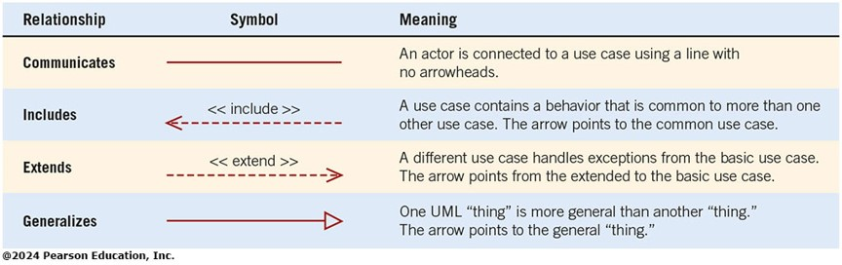
Figure 2.13 Four Types of U M L Behavioral Relationships and the Arrows and Lines Used to Represent the Relationships
Notes:
Long description:
The table is as follows. Relationship Symbol Meaning Communicates A horizontal solid line. An actor is connected to a use case using a line with no arrowheads. Includes A dashed arrow with arrow head on the left end. A use case contains a behavior that is common to more than one other use case. The arrow points to the common use case. Extends A dashed arrow with arrow head on the right end. A different use case handles exceptions from the basic use case. The arrow points from the extended to the basic use case. Generalizes A solid arrow with arrow head on the right end. One UML "thing” is more general than another thing. The arrow points to the general thing.

Slide 31
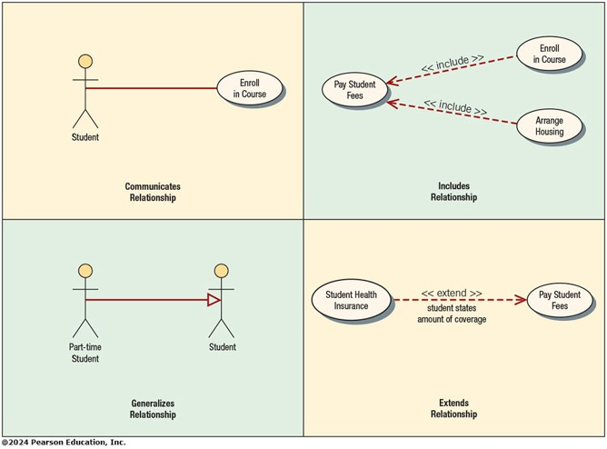
Figure 2.14 Examples of Use Cases and Behavioral Relationships for Student Enrollment
Notes:
Communicates—used to connect an actor to a use case. The task of the use case is to give some sort of result that is beneficial to the actor in the system.
Includes—describes the situation in which a use case contains behavior that is common to more than one use case.
Extends—describes the situation in which one use case possesses the behavior that allows the new use case to handle a variation or exception from the basic use case.
Generalizes—implies that one thing is more typical than the other thing.
Long Description:
Communicates Relationship: A solid line connecting "Student" and "Enroll in Course." Includes Relationship: A dashed left arrow each from "Enroll in Course" and "Arrange Housing" to "Pay Student Fees." Generalizes Relationship: A solid right arrow from "Part-time Student" to "Student." Extends Relationship: A dashed right arrow from "Student Health Insurance" to "Pay Student Fees." The text below the arrow reads, "student states amount of coverage."

Slide 32
Scope
System scope defines its boundaries:
What is in or outside the system
Project has a budget that helps to define scope
Project has a start and an end time
Actors are always outside of scope
Communication lines are the boundaries and define the scope

Slide 33
Developing Use Case Diagrams
Review the business specifications and identify the actors involved
Identify the high-level events and develop the primary use cases that describe those events and how the actors initiate them
Review each primary use case to determine the possible variations of flow through the use case
The context-level data flow diagram could act as a starting point for creating a use case
Notes:
When diagramming a use case, start by asking the users to list everything the system should do for them.

Slide 34
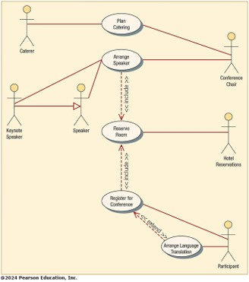
Figure 2.15 A Use Case Diagram Representing a System Used to Plan a Conference
Notes:
Example of a use case diagram representing a system used to plan a conference.
Long description:
The diagram shows various relationships in the plan as follows. A solid line between "Caterer" and "Plan Catering." A solid line between "Conference Chair" and "Plan Catering." A solid line between "Conference Chair" and "Arrange Speaker." A solid line between "Keynote Speaker" and "Arrange Speaker." A solid line between "Speaker" and "Arrange Speaker." A solid right arrow between "Keynote Speaker" and "Speaker." A dashed arrow (include) between "Arrange Speaker" and "Reserve Room." A dashed arrow (include) between "Reserve Room" and "Register for Conference." A solid line between "Reserve Room" and "Hotel Reservations." A dashed arrow (extend) between "Register for Conference" and "Arrange Language Translation." A solid line between "Register for Conference" and "Participant." A solid line between "Arrange Language Translation" and "Participant."

Slide 35
Developing the Use Case Scenarios
The description of the use case
Three main areas:
Use case identifiers and initiators
Steps performed
Conditions, assumptions, and questions
Notes:
Each use case has a description referred to as the use case scenario.

Slide 36
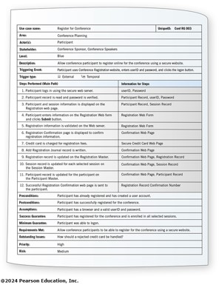
Figure 2.16 A Use Case Scenario is Divided into Three Sections
Notes:
(First area)
Use case identifiers and initiators—orients the reader and contains:
1. The use case name and a unique ID
2. The application area or system that this use case belongs to
3. The actors involved in the use case
4. A brief description of what the use case accomplishes
5. The triggering event
6. Type of trigger:
external or temporal
external—those started by an actor
temporal—triggered or started by time
7. May list stakeholders
(Second area)
Includes the steps performed, and the information required for each of the steps.
(Third area)
Preconditions
Post conditions
Assumptions
Outstanding issues
Statement of priority (optional)
Statement of risk (optional)
Long Description:
Use case name: Register for Conference Blank Unique I D: Conf R G 003 Area: Conference Planning Blank Blank Actor(s): Participant Blank Blank Stakeholder: Conference Sponsor, Conference Speakers Blank Blank Level: Blue Blank Blank Description: Allow conference participant to register online for the conference using a secure Website. Blank Blank Triggering Event: Participant uses Conference Registration Website, enters user I D and password, and clicks the logon button. Blank Blank Trigger type: External and temporal Blank Blank Steps Performed (Main Path) Blank Information for Steps Blank 1. Participant logs in using the secure Web server. Blank User I D, Password Blank 2. Participant record is read and password is verified. Blank Participant Record, user I D, Password Blank 3. Participant and session information is displayed on the Registration Web page. Blank Participant Record, Session Record Blank 4. Participant enters information on the Registration Web form and clicks Submit button. Blank Registration Web Form Blank 5. Registration information is validated on the Web server. Blank Registration Web Form Blank 6. Registration Confirmation page is displayed to confirm registration information. Blank Confirmation Web Page Blank 7. Credit card is charged for registration fees. Blank Secure Credit Card Web Page Blank 8. Add Registration Journal record is written. Blank Confirmation Web Page Blank 9. Registration record is updated on the Registration Master. Blank Confirmation Web Page, Registration Record Blank 10. Session record is updated for each selected session on the Session Master. Blank Confirmation Web Page, Session Record Blank 11. Participant record is updated for the participant on the Participant Master. Blank Confirmation Web Page, Participant Record Blank 12. Successful Registration Confirmation Web page is sent to the participant. Blank Registration Record Confirmation Number Blank Preconditions: Participant has already registered and has created a user account. Blank Blank Postconditions: Participant has successfully registered for the conference. Blank Blank Assumptions: Participant has a browser and a valid user I D and password. Blank Blank Success Guarantee: Participant has registered for the conference and is enrolled in all selected sessions. Blank Blank Minimum Guarantee: Participant was able to logon. Blank Blank Requirements Met: Allow conference participants to be able to register for the conference using a secure Website. Blank Blank Outstanding Issues: How should a rejected credit card be handled? Blank Blank Priority: High Blank Blank Risk: Medium Blank Blank

Slide 37
Use Case Header Area
Has a name and a unique I D
Include application area
List actors
Include stakeholders
Include the level
Has a brief description of the use case

Slide 38
Use Case Levels
Use case levels describe how global or detailed the use case description is:
White (like clouds): enterprise level
Kite: business unit or department level
Blue (sea level): user goals
Indigo (or fish): functional or subfunctional
Black (or clam): most detailed

Slide 39
Alternative Scenarios
Extensions or exceptions to the main use case
Number with an integer, decimal point, integer
Steps that may or may not always be used

Slide 40
Use Case Footer Area
Preconditions—need to be met before use case can be performed
Postconditions or the state of the system after the use case has finished
Assumptions
Minimal guarantee
Success guarantee
Outstanding issues
Optional priority and risk

Slide 41
Four Steps Used to Create Use Cases
Use agile stories, problem definition objectives, user requirements, or a features list
Ask about the tasks that must be done
Determine if there are any iterative or looping actions
The use case ends when the customer goal is complete

Slide 42
Why Use Case Diagrams Are Helpful
Identify all the actors in the problem domain
Actions that need to be completed are also clearly shown on the use case diagram
The use case scenario is also worthwhile
Simplicity and lack of technical detail
Notes:
Identify all the actors in the problem domain—the systems analyst can concentrate on what humans want and need to use the system, extend their capabilities, and enjoy their interaction with technology.
Actions that need to be completed are also clearly shown on the use case diagram—this makes it easy for the analyst to identify processes and aids in communication with other analysts on the team and business executives
The use case scenario is also worthwhile—because a lot of the information the users impart to the analysts are in story form, it is easy to capture on the use case scenario form.
Simplicity and lack of technical detail—used to show the scope of a system, along with the major features of the system and the actors that work with those major features.

Slide 43
Reasons for Writing Use Cases
Use cases effectively communicate systems requirements because the diagrams are kept simple.
Use cases allow people to tell stories.
Use case stories make sense to nontechnical people.
Use cases do not depend on a special language.
Use cases can describe most functional requirements (such as interactions between actors and applications).
Use cases can describe nonfunctional requirements (such as performance and maintainability) through the use of stereotypes.
Use cases help analysts define boundaries.
Use cases can be traceable, allowing analysts to identify links between use cases and other design and documentation tools.

Slide 44
Figure 10.4 An Overall View of U M L and Its Components: Things, Relationships, and Diagrams (1 of 2)
U M L Category | U M L Elements | Specific U M L Details
Things | Structural Things | Classes Interfaces Collaborations Use Cases Active Classes Components Nodes
Things | Behavioral Things | Interactions State Machines
Things | Grouping Things | Packages
Things | Annotational Things | Notes
Relationships | Structural Relationships | Dependencies Aggregations Associations Generalizations

Slide 45
Figure 10.4 An Overall View of U M L and Its Components: Things, Relationships, and Diagrams (2 of 2)
U M L Category | U M L Elements | Specific U M L Details
Relationships | Behavioral Relationships | Communicates Includes Extends Generalizes
Diagrams | Structural Diagrams | Class Diagrams Component Diagrams Deployment Diagrams
Diagrams | Behavioral Diagrams | Use Case Diagrams Sequence Diagrams Communication Diagrams Statechart Diagrams Activity Diagrams

Slide 46
Commonly Used U M L Diagrams (1 of 2)
Use case diagram
Describing how the system is used
The starting point for U M L modeling
Use case scenario
A verbal articulation of exceptions to the main behavior described by the primary use case
Activity diagram
Illustrates the overall flow of activities

Slide 47
Commonly Used U M L Diagrams (2 of 2)
Sequence diagrams
Show the sequence of activities and class relationships
Class diagrams
Show classes and relationships
Statechart diagrams
Show the state transitions
Notes:
Each use case may create one or more sequence diagrams.
Statechart diagrams—useful for determining class methods.

Slide 48
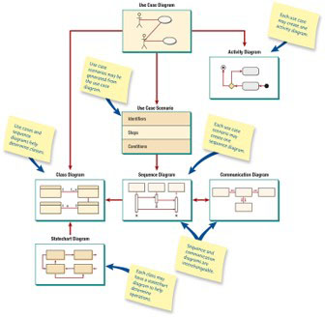
Figure 10.5 An Overview of U M L Diagrams Showing How Each Diagram Leads to the Development of Other U M L Diagrams
Notes:
Long Description:
The illustration gives the following information: Use Case Diagram, which branches out to Class diagram; Use case scenario; and Activity diagram. Class Diagram has a note reading Use cases and sequence diagrams help determine classes; it is pointed to by statechart diagram, which has a note reading each class may have a statechart diagram to help determine operations. Use case Scenario points to Sequence diagram, which points to Class diagram, and connects in both directions with Communication diagram. Sequence diagram has a note reading each use case scenario may create one sequence diagram; a note pointing to both sequence and communication diagrams reads Sequence and communication diagrams are interchangeable. The Use case diagram shows the path of communication between two people. The Class diagram shows four rectangles in two rows of two, connecting clockwise from top left. The connecting lines are labelled clockwise: from left to right 1, and 1...asterisk in the upper row, and 1, and asterisk 1 in the bottom row. The Use case scenario shows three rows labelled with Identifiers, Steps, and Conditions. The Sequence diagram shows three rectangles connecting with three cylinders below them, where the middle cylinder is short while the other two are of same size. From left to right, each cylinder points to the next. The left cylinder also connects directly to the right one. All cylinders have X written below them. The Communication diagram shows three rectangles placed horizontally, connected to each other, with arrows pointing from the center out. There is another rectangle below the middle one, with arrows pointing from top to bottom. The State chart diagram shows four rectangles, where the top left rectangle points to the right and to the one below it; the top right points out of the diagram. The two rectangles at the bottom have arrows pointing in from the right, and from the right to the leftmost one, as well as from the left to the right. The Activity diagram shows a black dot on the bottom right, which points to a rounded rectangle on the left side, which points to a diamond. Two arrows from the diamond point to another rectangle in the upper row and to another circled dot above it.

Slide 49
Use Case Modeling
Describes what the system does, without describing how the system does it
Based on the interactions and relationships of individual use cases
Use case describes
Actor
Event
Use case
Notes:
In a use case, an actor using the system initiates an event that begins a related series of interactions in the system.
Use cases are used to document a single transaction or event.

Slide 50
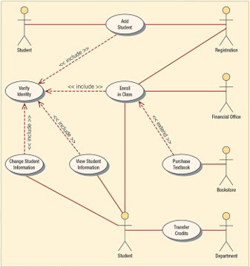
Figure 10.6 A Use Case Example of Student Enrollment
Notes:
Use case diagrams provide the basis for creating other types of diagrams such as class diagrams and activity diagrams.
Long Description:
The illustration is as follows: A student is connected to Add Student, which is also connected to Registration. Add student points with a dotted arrow to Verify Identity. Registration connects to Enroll in class. Verify identity is pointed to by dotted arrows labelled <<include>> from Add Student, Enroll in Class, View Student Information, and Change student information The Financial Office connects to Enroll in Class. The Bookstore connects to Purchase Textbook, which points to Enroll in Class with a dotted arrow labeled extend. Department connects to Transfer credits which connects to Student. The Student connects to Enroll in Class; View student Information; and Change Student information; all point to Verify Identity.

Slide 51
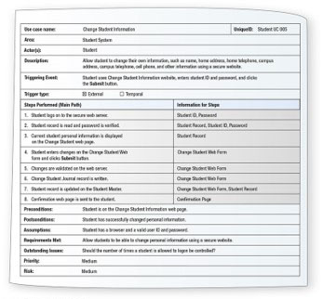
Figure 10.7 A Use Case Scenario is Divided into Three Sections: Identification and Initiation, Steps Performed, and Conditions, Assumptions, and Questions
Notes:
Use case scenarios are helpful in drawing sequence diagrams.
Long Description:
The Use-case scenario is as follows: Use case name: Change Student Information; Unique I D: Student U C 005 Area: Student System Actor(s): Student Description: Allow student to change his or her own information, such as name, home address, home telephone, campus address, campus telephone, cell phone, and other information using a secure website. Triggering Event: Student uses Change Student Information website, enters student ID and password, and clicks the Submit button. Trigger type: External, Checked, or Temporal Steps Performed (Main Path); Information for steps: 1. Student logs on to the secure web server; Student ID, Password 2. Student record is read and password is veriﬁed; Student Record, Student ID, Password 3. Current student personal information is displayed on the Change Student web page; Student Record 4. Student enters changes on the Change Student Web form and clicks Submit button; Change Student Web Form 5. Changes are validated on the web server; Change Student Web Form 6. Change Student Journal record is written; Change Student Web Form 7. Student record is updated on the Student Master; Change Student Web Form, Student Record. 8. Conﬁrmation web page is sent to the student; Confirmation Page Preconditions: Student is on the Change Student Information web page. Postconditions: Student has successfully changed personal information. Assumptions: Student has a browser and a valid user ID and password Requirements Met: Allow students to be able to change personal information using a secure website. Outstanding Issues: Should the number of times a student is allowed to logon be controlled? Priority: Medium Risk: Medium

Slide 52
Activity Diagrams
Show the sequence of activities in a process, including sequential and parallel activities, and decisions that are made
Symbols
Rectangle with rounded ends
Arrow
Diamond
Long, flat rectangle
Filled-in circle
Black circle surrounded by a white circle
Swimlanes
Notes:
An activity diagram is usually created for one use case and may show the different possible scenarios.

Slide 53
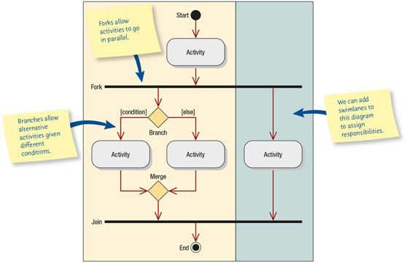
Figure 10.8 Specialized Symbols are Used to Draw an Activity Diagram
Notes:
Long Description:
The flow chart begins from the Start point and leads to Activity. The Activity points to a Fork. The Fork leads to a Branch, which points to one Activity with [condition] and to a second Activity with [else]. Both the Activities point to a Merge, which points to Join. The fork also points to a separate Activity, which also points to Join; this area is shown in a different color. The Join points to End. The notes pointing to different components in the flowchart read:
Forks allow activities to go in parallel.
Branches allow alternative activities given different conditions.
Ponting to the area in a different color: We can add swimlanes to this diagram to assign responsibilities.

Slide 54
Creating Activity Diagrams
Created by asking what happens first, what happens second, and so on
Must determine what activities are done in sequence or in parallel
The sequence of activities can be determined from physical data flow diagrams
Can be created by examining all the scenarios for a use case
Notes:
The sequence of activities can be determined from physical data flow diagrams—look for places that decisions are made, and ask what happens for each of the decision outcomes.
Can be created by examining all the scenarios for a use case—each path through the various decisions included on the use case is a different scenario.

Slide 55
Swimlanes
Useful to show how the data must be transmitted or converted
Help to divide up the tasks in a team
Makes the activity diagram one that people want to use to communicate with others
Notes:
Useful to show how the data must be transmitted or converted—such as from Web to server or from server to mainframe.
Help to divide up the tasks in a team—the analyst must ensure that the data that the various team members need is available and correctly defined.
The activity diagram provides a map of a use case, and allows the analyst to experiment with moving portions of the design to different platforms and ask “What if?” for a variety of decisions. The use of unique symbols and swimlanes makes this diagram one that people want to use to communicate with others.

Slide 56
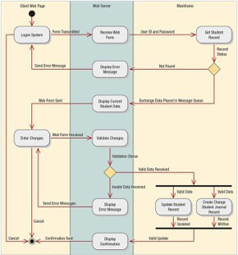
Figure 10.9 This Activity Diagram Shows Three Swimlanes: Client Web Page, Web Server, and Mainframe
Notes:
Long Description:
The diagram is as follows: The diagram shows three swimlanes: Client Web page, Web server, and Mainframe. The diagram starts from the Client Web Page, which points to the Logon System. The Logon System transmits Forms to Receive Web Form under Web Server, which sends User ID and Password to Get Student Record, under Mainframe. From there it sends record status to a branch represented by a diamond. The branch sends Not found to Display Error Message under Web server which sends an error message to the Logon System; or the branch sends Exchange data placed in Message Queue to Display Current Student Data under Web Server. From there, a Web form is sent to Enter Changes under Client Web Page. Enter Changes sends a Web Form Received to Validate Changes under Web Server. Validate Changes sends Validation Status to a branch. If Invalid Data is received, it is sent to Display Error Message, which sends Error Messages to Enter Changes. If Valid Data is received, it is sent to a fork to Update Student Record and to Create Change Student Journal Record. Record Updated; and Record Written respectively are sent to a Join and on to Display Confirmation. Confirmation is then sent and Activity terminates. It is also possible for the Login System to send a Cancel message and end the process.

Slide 57
Activity Diagrams and Test Plans
Activity diagrams may be used to construct test plans
Each event must be tested to see if the system goes to the next state
Each decision must be tested

Slide 58
Activity Diagrams Not Created for All Use Cases
Use an activity diagram when:
It helps to understand the activities of a use case
The flow of control is complex
There is a need to model workflow
When all scenarios for a use case need to be shown

Slide 59
Sequence Diagrams
Illustrate a succession of interactions between classes or object instances over time
Often used to show the processing described in use case scenarios
Used to show the overall pattern of the activities or interactions in a use case
Notes:
In practice, sequence diagrams are derived from use case analysis and are used in systems design to derive the interactions, relationships, and methods of the objects in the system.
Each use case scenario may create one sequence diagram, although sequence diagrams are not always created for minor scenarios.

Slide 60
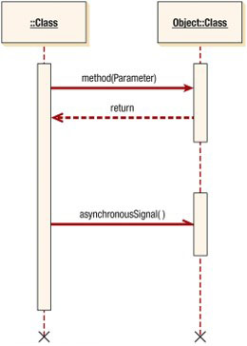
Figure 10.10 Specialized Symbols Used to Draw a Sequence Diagram
Notes:
The boxes along the top of the diagram show the actors and classes or object instances.
The left-most object is the starting object and may be a person, window, dialog box, or other user interface.
A vertical line represents the lifeline for the class or object, which corresponds to the time from when it is created through when it is destroyed.
Horizontal arrows show messages or signals that are sent between the classes.
Timing is displayed from top to bottom; the first interaction is drawn at the top of the diagram, and the interaction that occurs last is drawn at the bottom of the diagram.
Long Description:
Two rectangles read, Class; and Object, Class. The rectangle depicting, Class is linked with a dotted line to a long cylindrical shape below it; which is linked with a dotted line to an X below it. The rectangle depicting Object, Class is linked to a small cylinder by a dotted line and again to another small cylinder by a dotted line. The second cylinder is linked again to an X below it with a dotted line. The long cylinder on the left points a solid arrow labeled method (Parameter) to the first small cylinder on right. The small cylinder points back with a dotted arrow labeled return. The longer cylinder points to the second small cylinder with a solid arrow labeled asynchronous Signal ().

Slide 61
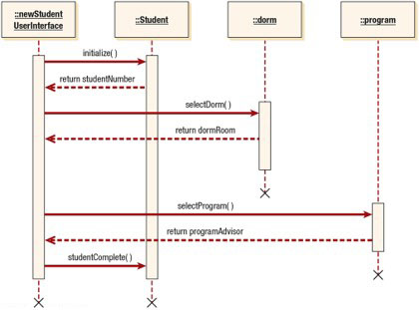
Figure 10.11 A Sequence Diagram for Student Admission: Sequence Diagrams Emphasize the Time Ordering of Messages
Notes:
During the systems design phase, the sequence diagrams are defined to derive the methods and interactions between classes.
Long Description:
In the sequence diagram, the top row contains four rectangles, labeled ::new Student User Interface; ::Student; ::dorm; and ::program. ::new Student User Interface and Student each link below to long cylinders of equal size with dotted lines. ::dorm links to a shorter third cylinder that starts below the top of the first two. ::program links to a smaller fourth cylinder below the level of the third. The first cylinder points to the second cylinder with a solid arrow marked initialize(). A dotted arrow labeled as return student Number points from the second cylinder to the first. The first cylinder points to the third cylinder with a solid arrow, labeled select Dorm(); and a dashed arrow labeled return dorm Room points back to the first cylinder. The third cylinder connects with a dashed line to an X below. The rectangle depicting program links to the smallest cylinder below it with a longer broken line. The first cylinder points to the fourth cylinder with a solid arrow labeled select Program(). The small cylinder points back at first cylinder with a broken arrow, labeled return program Advisor. The fourth cylinder is connected below to a dashed line ending in an X. The first cylinder points to the second cylinder with a solid arrow labeled student Complete(). Both the cylinders end with a dotted line to an X below them.

Slide 62
Communication Diagrams
Describes the interactions of two or more things in the system that perform a behavior that is more than any one of the things can do alone
Shows the same information as a sequence diagram, but may be more difficult to read
Emphasizes the organization of objects
Made up of objects, communication links, and the messages that can be passed along those links
Notes:
In order to show time ordering you must indicate a sequence number and describe the message.

Slide 63
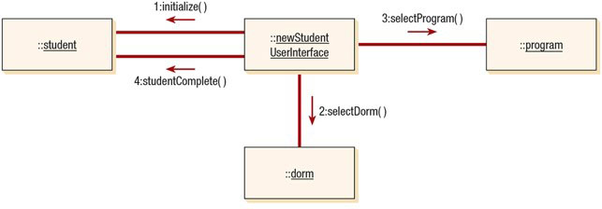
Figure 10.12 A Communication Diagram for Student Admission
Communication diagrams show the same information that is depicted in a sequence diagram but emphasize the organization of objects rather than the time ordering.
Notes:
Long Description:
In the diagram there are four components. The first three components are placed horizontally in the first row, and are labeled student, new Student User Interface, and program. The new Student User Interface is connected to student by connectors with arrows labeled 1: initialize (), and 4:student Complete (). The new student username is also linked to the fourth component, Dorm, below it, with a connector with an arrow labeled 2: select Dorm (); and to Program on the right with a connector and arrow labeled 3: select Program ().

Slide 64
Class Diagrams (1 of 2)
Show the static features of the system and do not represent any particular processing
Show the nature of the relationships between classes
Show data storage requirements as well as processing requirements

Slide 65
Class Diagrams (2 of 2)
Classes
Attributes
Private
Public
Protected
Methods
Standard
Custom
Notes:
Classes—represented by a rectangle on the class diagram.
Attributes—what the class knows about the characteristics of the objects:
Private—only available in the object
Public—visible to other objects outside its class
Protected—hidden from all classes except immediate subclasses
Methods—small sections of code that work with the attributes:
Standard—basic things that all classes of object know how to do
Custom—designed for a specific class

Slide 66
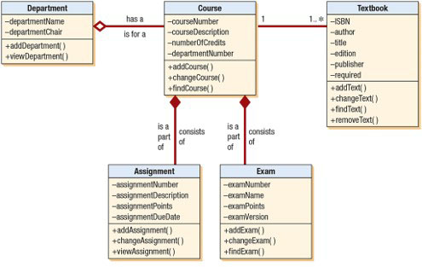
Figure 10.13 A Class Diagram for Course Offerings: the Filled-In Diamonds Show Aggregation and the Empty Diamond Shows a Whole-Part Relationship
Notes:
Long Description:
The diagram depicts:
From left to right, the diagram starts with the class Department with the attributes
minus departmentName
minus departmentChair
Plus addDepartment( )
Plus viewDepartment( )
These are connected by an open diamond and a link to the class Course with the attributes
minus courseNumber
minus courseDescription
minus numberOfCredits
minus departmentNumber
Plus addCourse( )
Plus changeCourse( )
Plus ﬁndCourse( )
the class Course is connected with a line to the class Textbook on the right. The left side of the line shows 1 and right side of the line shows 1..asterisk.
Textbook attributes are:
minus ISBN
minus author
minus title
minus edition
minus publisher
minus required
Plus addText( )
Plus changeText( )
Plus ﬁndText( )
Plus removeText( )
Course is connected below to the classes Assignment and Exam with a solid diamond at the Course end of the connections. The connectors connecting Course and Assignment, and both connectors are labeled Is a part of; and consists of. The class Assignment includes attributes:
minus assignmentNumber
minus assignmentDescription
minus assignmentPoints
minus assignmentDueDate
Plus addAssignment( )
Plus changeAssignment( )
Plus viewAssignment( )
Exam has the attributes
minus examNumber
minus examName
minus examPoints
minus examVersion
Plus addExam( )
Plus changeExam( )
Plus ﬁndExam( )
The line between department and course is labeled, has a at the top and is for a at the bottom.

Slide 67
Method Overloading
Including the same method (or operation) several times in a class
The same method may be defined more than once in a given class, as long as the parameters sent as part of the message are different
Notes:
Example: plus sign

Slide 68
Types of Classes
Entity classes
Interface classes
Abstract classes
Control classes

Slide 69
Entity Classes
Represent real-world items
The entities represented on an entity-relationship diagram
Notes:
Represent real-world items—such as people, things , and so on.
The entities represented on an entity-relationship diagram—CASE tools will allow you to create a UML entity class from an entity on an E-R diagram.

Slide 70
Interface or Boundary Classes
Provide a means for users to work with the system
Human interfaces may be a display, window, Web form, dialogue box, touch-tone telephone, or other way for users to interact with the system
System interfaces involve sending data to or receiving data from others
Notes:
The attributes of these classes are those found on the display or report. The methods are those required to work with the display, or produce the report.

Slide 71
Abstract Classes (1 of 2)
Linked to concrete classes in a generalization/specialization relationship
Cannot be directly instantiated

Slide 72
Control Classes
Used to control the flow of activities
Many small control classes can be used to achieve classes that are reusable
Notes:
Often a control class will be derived just to make another class reusable (example: logon process).
The rules for creating sequence diagrams are that all interface classes must be connected to a control class and in a similar fashion all entity classes must be connected to a control class.

Slide 73
Presentation, Business, and Persistence Layers
Sequence diagrams may be discussed using three layers:
Presentation layer, what the user sees, corresponding to the interface or boundary classes
Business layer, containing the unique rules for this application, corresponding roughly to control classes
Persistence or data access layer, for obtaining and storing data, corresponding to the entity classes

Slide 74
Defining Messages and Methods
Each message may be defined using a notation similar to that described for the data dictionary
The methods may have logic defined using structured English, a decision table, or a decision tree
Notes:
The techniques of horizontal balancing can be used with any class method.

Slide 75
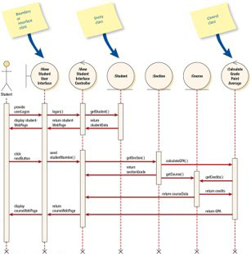
Figure 10.15 A Sequence Diagram for Using Two Web Pages: One for Student Information, One for Course Information
Notes:
Long Description:
From left to right, the diagram shows a Student as an actor followed by the classes View Student User Interface, also labeled Boundary or interface class; View Student Interface Controller; Student, also labeled entity class; Section; Course; and Calculate Grade Point Average, labeled Control Class. The diagram shows following sequences: For student information: ● The first sequence flowing forward from Student as an actor to View student user interface to Student shows: provide userLogon, logon(), getStudent(). ● The sequence moving backward from Student to Student as an actor shows: return studentData, return student Webpage, display student WebPage. For Course information: ● Next sequence moving forward from Student as an actor to Section shows: Click nextButton, send studentNumber(), getSection(). ● The sequence moving backward from Section to Student shows return sectionGrade. ● The sequence moving forward from Section to Calculate Grade Point Average shows CalculateGPA(). ● The sequence moving forward from Section to Course shows getCourse(). ● The sequence moving backward from: Calculate Grade Point Average to :Course shows getCredits(). ● The sequence moving forward from Course to Calculate Grade Point Average shows returnCredits() ● The sequence moving backward from Course to View Student Interface Controller shows return courseData. ● The sequence moving backward from Grade Point Average to Student as an actor shows: return GPA, return courseWebPage, Display courseWebPage. The notes pointing to the following elements in the diagram show:

Slide 76
Create Sequence Diagrams
Include the actor from the use case diagram
Define one or more interface classes for each actor
Each use case should have one control class
Examine the use case to see what entity classes are required
The sequence diagram may be modified when doing detailed design

Slide 77
Creating a Test Plan from a Sequence Diagram
Does each method return correct results?
Ensure that entity classes store or obtain the correct attribute values
Verify that all JavaScript paths work correctly
Ensure that the server control classes work correctly
Ask, “What may fail?”
Determine what to do if something can fail

Slide 78
Relationships (2 of 2)
The connections between classes
Associations
Whole/part
Notes:
Associations—a structural connection between classes or objects.
Whole/part—when one class represents the whole object and other classes represent parts.

Slide 79
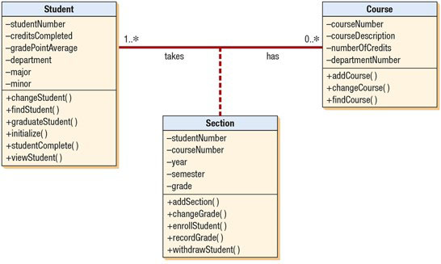
Figure 10.18 An Example of an Associative Class in Which a Particular Section Defines the Relationship between a Student and a Course
Notes:
Long Description:
The diagram connects Student 1. .asterisk with0 asterisk Course with a solid line. The class Section below connects to the line between Student and Course with a dotted line, dividing the line into two parts. The first part of solid line reads Takes and second part reads Has. The attributes are follows: Student: minus studentNumber minus creditsCompleted minus gradePointAverage minus department minus major minus minor Plus changeStudent( ) Plus ﬁndStudent( ) Plus graduateStudent( ) Plus initialize( ) Plus studentComplete( ) Plus viewStudent( ) Section: minus studentNumber minus courseNumber minus year minus semester minus grade Plus addSection( ) Plus changeGrade( ) Plus enrollStudent( ) Plus recordGrade( ) Plus withdrawStudent( ) Course: minus courseNumber minus courseDescription minus numberOfCredits minus departmentNumber Plus addCourse( ) Plus changeCourse( ) Plus ﬁndCourse( )

Slide 80
Associations
The simplest type of relationship
Association classes are those that are used to break up a many-to-many association between classes
An object in a class may have a relationship to other objects in the same class, called a reflexive association

Slide 81
Whole/Part Relationships
When one class represents the whole object, and other classes represent parts
Categories
Aggregation
Collection
Composition
Notes:
When one class represents the whole object, and other classes represent parts—the whole acts as a container for the parts.

Slide 82
Aggregation
A “has a” relationship
Provides a means of showing that the whole object is composed of the sum of its parts

Slide 83
Collection
Consists of a whole and its members
Members may change, but the whole retains its identity
A weak association
Notes:
Examples: a library with books or a voting district with voters.

Slide 84
Composition
The whole has a responsibility for the parts, and is a stronger relationship
If the whole is deleted, all parts are deleted
Notes:
Example: an insurance policy with riders.

Slide 85
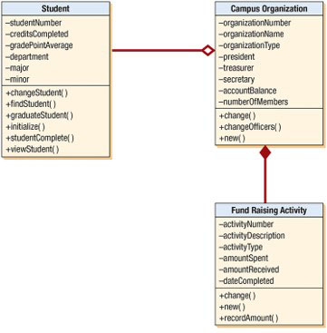
Figure 10.19 An Example of Whole-Part and Aggregation Relationships
Notes:
Long Description:
In the diagram, Student is connected to Campus organization, with an open diamond on the Campus Organization end.. The Fund-raising Activity is connected to Campus Organization with a solid diamond on the Campus Organization end. The information depicted is: Student: minus studentNumber minus creditsCompleted minus gradePointAverage minus department minus major minus minor Plus changeStudent( ) Plus ﬁndStudent( ) Plus graduateStudent( ) Plus initialize( ) Plus studentComplete( ) Plus viewStudent( ) Campus Organization: minus organizationNumber minus organizationName minus organizationType minus president minus treasurer minus secretary minus accountBalance minus numberOfMembers Plus change( ) Plus changeOfficers( ) Plus new( ) Fund Raising Activity minus activityNumber minus activityDescription minus activityType minus amountSpent minus amountReceived minus dateCompleted Plus change( ) Plus new( ) Plus recordAmount( )

Slide 86
Generalization/Specialization Diagrams
Generalization
Inheritance
Polymorphism
Abstract classes
Messages

Slide 87
Generalization
Describes a relationship between a general kind of thing and a more specific kind of thing
Described as an “is a” relationship
Used for modeling class inheritance and specialization
General class is a parent, base, or superclass
Specialized class is a child, derived, or subclass
Notes:
Example: a car is a vehicle, a truck is a vehicle.

Slide 88
Inheritance (2 of 2)
Helps to foster reuse
Helps to maintain existing program code
Notes:
Helps to foster reuse—because the code is used many times.
Helps to maintain existing program code—this allows the analyst to define attributes and methods once but use them many times, in each inherited class.

Slide 89
Polymorphism
The capability of an object-oriented program to have several versions of the same method with the same name within a superclass/subclass relationship
The subclass method overrides the superclass method
When attributes or methods are defined more than once, the most specific one is used
Notes:
The subclass method overrides the superclass method—
the subclass inherits a parent method but may add to it or modify it.
the subclass may change the type of data or change how the method works.
When attributes or methods are defined more than once, the most specific one is used—the compiled program walks up the chain of classes, looking for methods.

Slide 90
Abstract Classes (2 of 2)
Abstract classes are general classes
No direct objects or class instances, and is only used in conjunction with specialized classes
Usually have attributes and may have a few methods
Notes:
Abstract classes are general classes—used when gen/spec is included in the design.

Slide 91
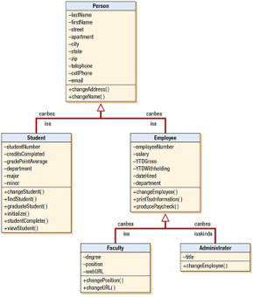
Figure 10.20 A Generalization/Specification Diagram is a Refined Form of a Class Diagram
Notes:
Person is an abstract class, with no instances.
Long Description:
From bottom to top, the diagram shows the following: Faculty and Administrator point to Employee showing: under the connecting line Faculty isa Employee; above the connecting line Faculty canbea employee. Above the connecting line, Administrator canbea Employee; above the line , Administrator isakinda Employee. Employee and Student point to Person, showing: Employee canbea Person above the connecting line; Employee isa Person below the connecting line. Student canbea Person above the line; Student isa Person below the line. The attributes of the classes are as follows: Faculty: minus degree minus position minus webURL Plus changePosition( ) Plus changeURL( ) Administrator: minus title Plus changeEmployee( ) Employee: minus employeeNumber minus salary minus YTDGross minus YTDWithholding minus dateHired minus department Plus changeEmployee( ) Plus printTaxInformation( ) Plus producePaycheck( ) Student: minus studentNumber Minus creditsCompleted Minus gradePointAverage minus department minus major minus minor Plus changeStudent( ) Plus ﬁndStudent( ) Plus graduateStudent( ) Plus initialize( ) Plus studentComplete( ) Plus viewStudent( ) Person: minus lastName minus ﬁrstName minus street minus apartment minus city minus state minus zip minus telephone minus cellPhone minus email Plus changeAddress( ) Plus changeName( )

Slide 92
Finding Classes
During interviewing or J A D sessions
During facilitated team sessions
During brainstorming sessions
Analyzing documents and memos
Examining use cases, looking for nouns
Notes:
Identify abstract classes by looking to see if a number of classes or database tables have the same elements, or if a number of classes have the same methods.
Analyzing documents and memos—use the CRC method.
Examining use cases, looking for nouns—each noun may lead to a candidate, or potential, class.

Slide 93
Determining Class Methods
Standard methods
Examine a C R U D matrix
Notes:
Standard methods –
new()
<<create>>

Slide 94
Messages
Used to send information by an object in one class to an object in another class
Acts as a command, telling the receiving class to do something
Consists of the name of the method in the receiving class, as well as the attributes that are passed with the method name
May be thought of as an output or an input
Notes:
Consists of the name of the method in the receiving class, as well as the attributes that are passed with the method name—the receiving class must have a method corresponding to the message name.
May be thought of as an output or an input—the first class must supply the parameters included with the message and the second class parameters.

Slide 95
Statechart Diagrams (1 of 2)
Used to examine the different states that an object may have
Created for a single class
Objects are created, go through changes, and are deleted or removed
Objects
States
Events
Signals or asynchronous messages
Synchronous
Temporal events
Notes:
Event—something that happens at a specific time and place.
Signals or asynchronous messages—occur when the calling program does not wait for a returning message.
Synchronous messages—calls to functions or subroutines.
Temporal events—occur at a predetermined time.

Slide 96
Statechart Diagrams (2 of 2)
Created when:
A class has a complex life cycle
An instance of a class may update its attributes in a number of ways through the life cycle
A class has an operational life cycle
Two classes depend on each other
The object’s current behavior depends on what happened previously
Notes:
Statechart diagrams are not created for all classes.

Slide 97
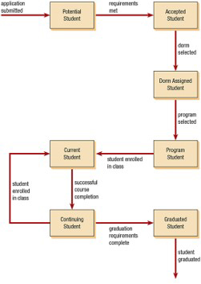
Figure 10.22 A Statechart Diagram Showing How a Student Progresses from a Potential Student to a Graduated Student
Notes:
Long Description:
From left to right, the diagram shows: Application Submitted leads to Potential Student. From there, after requirements are met, Potential student becomes Accepted Student. The Accepted student becomes Dorm Assigned Student, after dorm is selected. From there it leads to Program Student after program is selected, and with student enrolled in class, the student becomes Current Student. After successful course completion, Current student becomes Continuing Student, and again student is enrolled in class and becomes Current Student. If Graduation requirements are completed, Continuing Student becomes Graduated Student, and then student is graduated.

Slide 98
Packages
Containers for other U M L things
Show system partitioning
Can be component packages
Can be physical subsystems
Use a folder symbol
May have relationships
Notes:
Containers for other UML things—such as use cases or classes.
Show system partitioning—indicating which classes or use cases are grouped into a subsystem (logical packages).
Can be component packages—contain physical system components, or use case packages, containing a group of use cases.
Use a folder symbol—with the package name either in the folder tab or centered in the folder.
May have relationships—may include associations and inheritance.

Slide 99
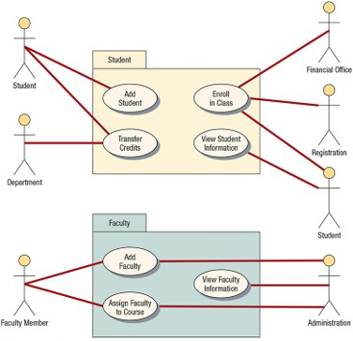
Figure 10.23 Use Cases Can Be Grouped into Packages
Notes:
Long Description:
The diagram contains two parts. The first part is titled Student, inside which four ovals appear, labeled: Add Student, Enroll in Class, Transfer Credits, and View Student Information. On left side of the title, Student is linked to Add Student and Transfer Credit. The Department is linked to Transfer Credit. On the right side, the Financial Office and Registration are connected to Enroll in class, and Student is linked to Enroll in Class and View Student Information. The second part is titled Faculty. Three ovals are labeled: Add Faculty, Assign Faculty, and View Faculty Information. On the left side of the title, Faculty member is linked to Add Faculty, and Assign Faculty. On the right side, Administration is linked with all the three components.

Slide 100
Putting U M L to Work
The steps used in U M L are:
Define the use case model
Continue U M L diagramming to model the system during the systems analysis phase
Develop the class diagrams
Draw statechart diagrams
Begin systems design by refining the U M L diagrams
Document your system design in detail
Notes:
The analyst will initially use the UML toolset to break down the system requirements into a use case model and an object model. The use case model describes the use cases and actors. The object model describes the objects and object associations, and the responsibilities, collaborators, and attributes of the objects.
“Putting a project on paper before coding will wind up costing less in the long run. It’s much cheaper to erase a diagram than it is to change coding.”

Slide 101
Summary (1 of 2)
Object-oriented systems
Objects
Classes
Inheritance
C R C cards
U M L and use case modeling
Components of U M L
Things
Relationships
Diagrams

Slide 102
Summary (2 of 2)
U M L diagrams
Use case diagrams
Activity diagrams
Sequence diagrams
Communication diagrams
Class diagrams
Statechart diagrams
Using U M L

